Slide 1


Reinforcement Learning for Portfolio Management Part I
Jun-Jie Chen
2018-09-10

Slide 2


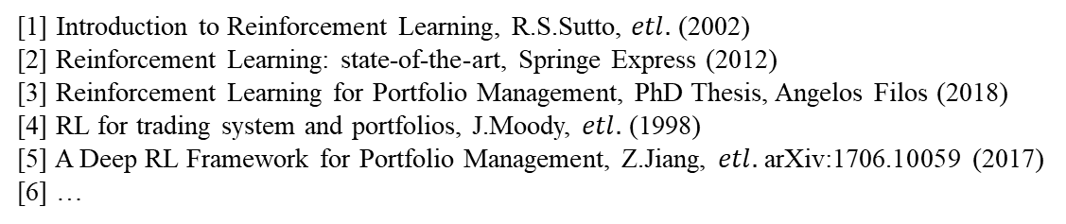
Outline
Introduction to RL
a) Markov decision process (MDP) and Bellman equation
b) Watkins’s off-policy Q-learning algorithm and example
c) Deep-Q-learning with experience replay, Fitted-Q-iteration
Portfolio management as a RL task
a) Big 3 in financial market
b) Toy model: deep-Q-learning agent for single asset universe
c) Possible improvements in the near future
Summary
[1] Introduction to Reinforcement Learning, R.S.Sutto, $etl.$ (2002)
[2] Reinforcement Learning: state-of-the-art, Springe Express (2012)
[3] Reinforcement Learning for Portfolio Management, PhD Thesis, Angelos Filos (2018)
[4] RL for trading system and portfolios, J.Moody, $etl.$ (1998)
[5] A Deep RL Framework for Portfolio Management, Z.Jiang, $etl.$arXiv:1706.10059 (2017)
[6] …
Notes:
转折顺畅

Slide 3
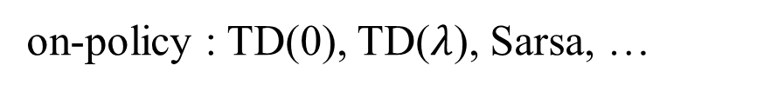
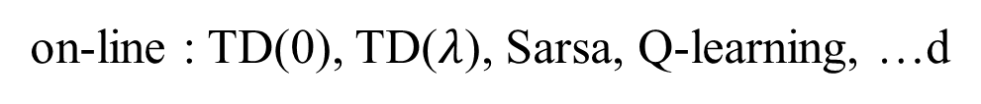
Framework
on-line : TD(0), TD($λ$), Sarsa, Q-learning, …d
RL
off-line : KADP, FQI, LSQI, …
on-policy : TD(0), TD($λ$), Sarsa, …
RL
off-policy : Q-learning, …
value iteration : Q-value, V-value, …
RL
policy gradients : PG, A3C, DDPG…

Slide 4
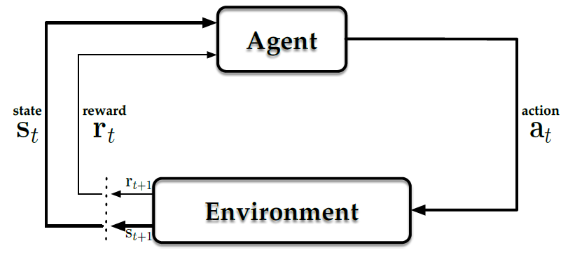

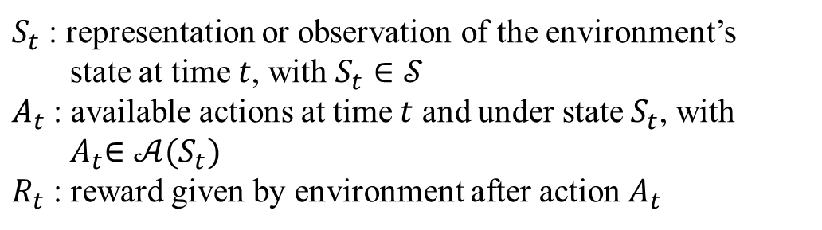
Introduction to RL: MDP & BE
General dynamical system
$S_{t}$ : representation or observation of the environment’s
state at time $t$, with $S_{t}∈𝒮$
$A_{t}$ : available actions at time $t$ and under state $S_{t}$, with ${ A}_{t}∈𝒜(S_{t})$
$R_{t}$ : reward given by environment after action $A_{t}$
explore
exploit
A state $S_{t}$ satisfies Markov property if and only if
$$P\left[S_{t+1} | S_{t},S_{t−1},…,S_{1}\right]=P[S_{t+1}|S_{t}]$$
Such dynamical system with its states owning Markov property is call Markov decision process (MDP)

Slide 5
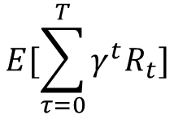



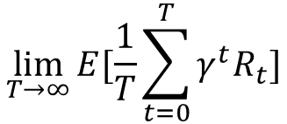

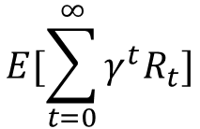
Introduction to RL: MDP & BE
The ultimate goal of controlling MDP is to find a policy
Deterministic: $A_{t+1}=π(S_{t})$
$$π: 𝒮→𝒜$$
Stochastic: $π\left(a | s\right)=P[A_{t}=a|S_{t}=s]$
to maximize the cumulated reward
$$E[\sum_{τ=0}^{T}{{γ^{t}R}_{t}}]$$
$$E[\sum_{t=0}^{∞}{γ^{t}R_{t}}]$$
$$\lim_{T→∞}{E[\frac{1}{T}\sum_{t=0}^{T}{{γ^{t}R}_{t}}]}$$
$$G=$$
finite horizon
infinite horizon
average reward
Then the optimal policy is the one that satisfies
$$π^{∗}=arg\max_{π}{G}$$

Slide 6


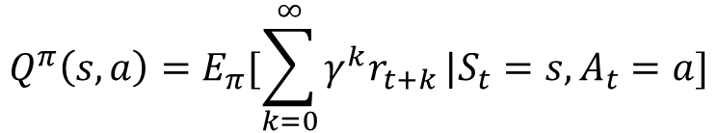
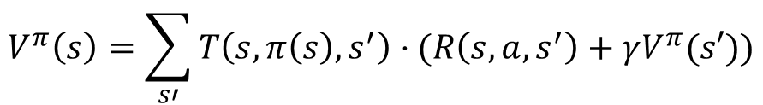
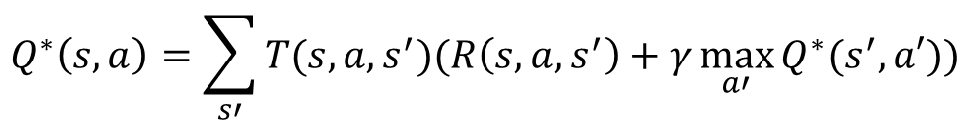


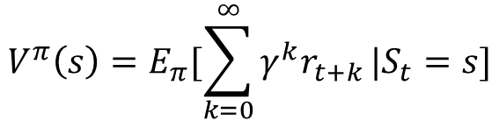

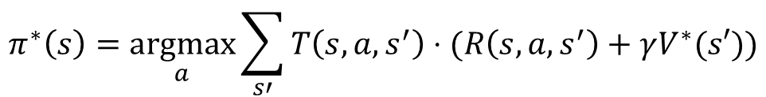
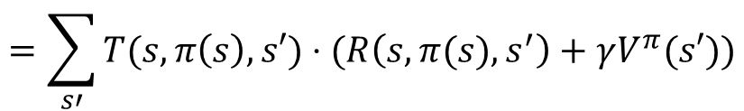


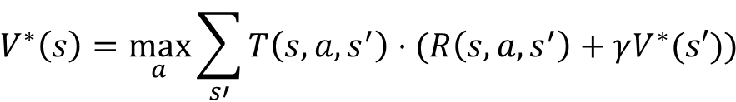
Introduction to RL: MDP & BE
Value function $V$ and $Q$
For a given policy $π$, define
$$V^{π}\left(s\right)=E_{π}[\sum_{k=0}^{∞}{γ^{k}r_{t+k}}|S_{t}=s]$$
$$Q^{π}\left(s,a\right)=E_{π}[\sum_{k=0}^{∞}{γ^{k}r_{t+k}}|S_{t}=s,A_{t}=a]$$
Bellman equation of $V$
optimal Bellman equation of $Q$
$$V^{π}\left(s\right)=\sum_{s′}{T\left(s,π\left(s\right),s^{′}\right)⋅(R\left(s,a,s^{′}\right)+γV^{π}(s′))}$$
$$Q^{∗}\left(s,a\right)=\sum_{s′}{T(s,a,s^{′})(R\left(s,a,s^{′}\right)+γ\max_{a′}{Q^{∗}(s^{′},a′)})}$$
$$V^{π}\left(s\right)=E_{π}[r_{t}+γr_{t+1}+γ^{2}r_{t+2}+…|S_{t}=s]$$
For optimal policy $π^{∗}$, by definition we have
$$V^{∗}\left(s\right)=\max_{a}{Q^{∗}(s, a)}$$
$$=E_{π}[r_{t}+γV^{π}(S_{t+1})|S_{t}=s]$$
$$V^{∗}\left(s\right)=\max_{a}{\sum_{s′}{T\left(s,a,s^{′}\right)⋅(R\left(s,a,s^{′}\right)+γV^{∗}(s′))}}$$
$$π^{∗}\left(s\right)=\underset{a}{argmax}{Q^{∗}(s, a)}$$
$$=\sum_{s′}{T(s,π\left(s\right),s′)}⋅(R\left(s,π(s),s^{′}\right)+γV^{π}(s′))$$
$$π^{∗}\left(s\right)=\underset{a}{argmax}{\sum_{s′}{T\left(s,a,s^{′}\right)⋅(R\left(s,a,s^{′}\right)+γV^{∗}(s′))}}$$
$T(s,a,s^{′})$ is known: model-based
$T(s,a,s^{′})$ is unknown: model-free

Slide 7
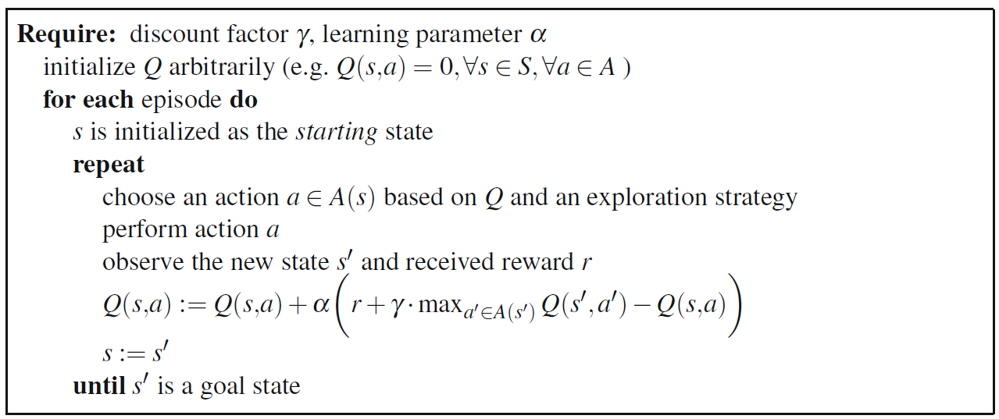
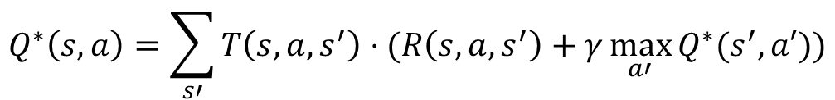
Introduction to RL: Q-learning
$$Q^{∗}\left(s,a\right)=\sum_{s′}{T\left(s,a,s^{′}\right)⋅(R\left(s,a,s^{′}\right)+γ\max_{a′}{Q^{∗}(s^{′},a′)})}$$
$$Q\left(s,a\right)←Q\left(s,a\right)+α[r+γ\max_{a^{′}}{Q\left(s^{′},a^{′}\right)}−Q\left(s,a\right)]$$
Watkins Q-learning: for each transition $\left(S_{t},A_{t},S_{t+1},R_{t}\right)=(s,a,s^{′},r)$
$$Q\left(s,a\right)←Q\left(s,a\right)+α[r+γ\max_{a^{′}}{Q\left(s^{′},a^{′}\right)}−Q\left(s,a\right)]$$
explore & exploit dilemma
in which, $α$ is the learning rate, $γ$ is the discounted factor
Watkins(1989) proves that such iteration will converge to optimal $Q^{∗}$ under given conditions

Slide 8
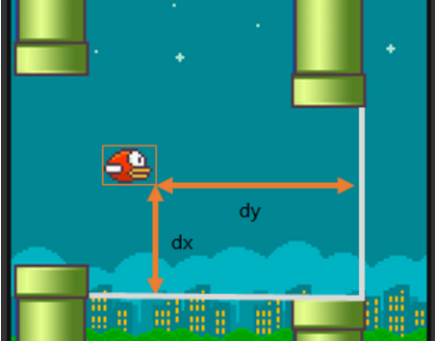
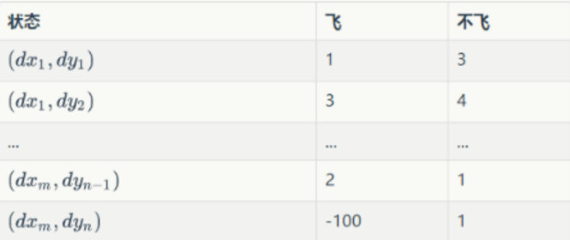

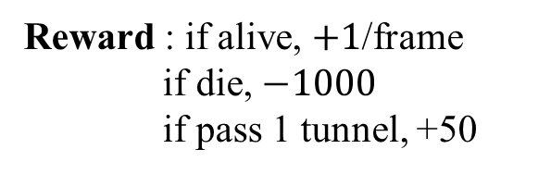

Introduction to RL: Q-learning example
Flappy-Bird
$Q(s,a)$ can be treated as a table
State : $(dx, dy)$
Action : jump or do nothing
$Q\left(s,a\right)$ is updated by using Watkins’s Q-learning
Reward : if alive, $+1$/frame
if die, $−1000$
if pass 1 tunnel, +50
$$Q\left(s,a\right)←Q\left(s,a\right)+α[r+γ\max_{a^{′}}{Q\left(s^{′},a^{′}\right)}−Q\left(s,a\right)]$$

Slide 9






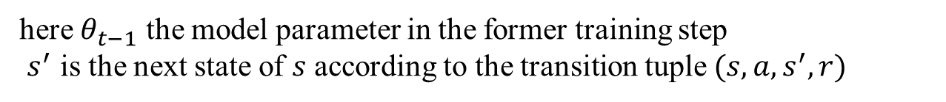
Introduction to RL: DQL & FQI
For continuous state space $𝒮$ and discrete action space $𝒜$, tabular Q-learning is no longer feasible. We need a powerful parametric model to approximate the $Q(s,a)$ function
Deep-Q-learning (DQL)
$$Q\left(s,a\right)←Q\left(s,a\right)+α[r+γ\max_{a^{′}}{Q\left(s^{′},a^{′}\right)}−Q\left(s,a\right)]$$
the $Q$ function converges only when
$$Q(s,a_{1})$$
$$Q\left(s,a\right)=r+γ⋅\max_{a′}{Q(s^{′},a^{′})}$$
$$Q(s,a_{2})$$
thus at training step $t$, the target value (labels) for the network is
$$s$$
$$Q(s,a_{3})$$
$$r+γ⋅\max_{a′}{Q(s^{′},a^{′};θ_{t−1})}$$
neural network
here $θ_{t−1}$ the model parameter in the former training step
$s^{′}$ is the next state of $s$ according to the transition tuple $(s,a,s^{′},r)$

Slide 10





Introduction to RL: DQL & FQI
Experience replay in DQL
on-line update of Q-function is noisy, data usage is low, convergence is very slow
experience replay is an important technique proposed by DeepMind in 2015 for Atari games simulation
replay buffer
Deep Q-network
$$(s_{5},a_{5},s_{5}^{′},r_{5})$$
$$(s_{1},a_{1},s_{1}^{′},r_{1})$$
$$(s_{2},a_{2},s_{2}^{′},r_{2})$$
$$(s_{4},a_{4},s_{4}^{′},r_{4})$$
$$(s_{3},a_{3},s_{3}^{′},r_{3})$$
mini batch
...
...
...
activation

Slide 11

Introduction to RL: DQL & FQI
Experience replay in DQL
on-line update of Q-function is noisy, data usage is low, convergence is very slow
experience replay is an important technique proposed by DeepMind in 2015 for Atari games simulation
replay buffer
Deep Q-network
$$(s_{6},a_{6},s_{6}^{′},r_{6})$$
$$(s_{5},a_{5},s_{5}^{′},r_{5})$$
mini batch
$$(s_{4},a_{4},s_{4}^{′},r_{4})$$
$$(s_{3},a_{3},s_{3}^{′},r_{3})$$
...
...
...
activation
$$(s_{2},a_{2},s_{2}^{′},r_{2})$$
$$(s_{1},a_{1},s_{1}^{′},r_{1})$$

Slide 12

Introduction to RL: DQL & FQI
Pseudo-code of DQL
Require: discounted factor $γ$, learning rate $α$, buffer size
initialize Q-network arbitrarily
for ep in num of episodes:
from state $s$ choose action $a$ according to a given strategy, then obtains
the transition $(s,a,s^{′},r)$
if replay buffer is not full:
add $(s,a,s^{′},r)$ into the buffer
else:
add $(s,a,s^{′},r)$ into the buffer and pop out the old experience
randomly choose a mini batch from the buffer
update the target value
$\left(s,a\right)→r+γ⋅\max_{a^{′}}{Q\left(s^{′},a^{′}\right)} if not terminal$
$\left(s,a\right)→r if at terminal$
feed the mini batch of tuple $(\left(s,a\right), target)$ to the Q-network
$s=s′$
until terminal

Slide 13

Introduction to RL: DQL & FQI
Fitted-Q-Iteration : an off-line version of DQL
The FQI is a pure off-line RL algorithm. The FQI agent no longer interacts with the environment. Instead, it just handles the existing historic data of transitions $(s,a,s^{′},r)$
Require: discounted factor $γ$, learning rate $α$, historic transition set $𝒳$
initialize Q-network arbitrarily
Repeat
update the target value
$\left(s,a\right)→r+γ⋅max_{a^{′}}{Q\left(s^{′},a^{′}\right)} if not terminal$
$\left(s,a\right)→r if at terminal$
feed the tuples $(\left(s,a\right),target)$ to the Q-network (batch training)
Until Q-network converges

Slide 14
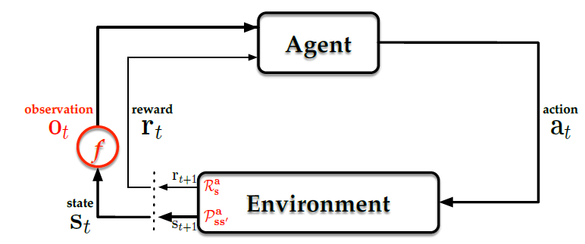
RL in Finance: The Big Three
There are some major difference in financial market when we apply RL on it
(1) Information of financial market is inadequate. All we can get is some observations in the history, for example, price and volume at different time. We need to form a predictive representation of market state based on such finite observation. Observation of financial market has low signal-to-noise ratio.
(2) It is hard to learn a financial market totally on line. To simulate the market, the following assumptions are necessary (or we can run in an off-line mode)
(i) Sufficient liquidity
Target assets are liquid and every transaction can be executed under the same conditions
(ii) Zero slippage
Each trade of the target assets can be carried out immediately at the price when order is placed
(iii) Zero market impact
The trading agent has no impact on the market supply and demand.

Slide 15




RL in Finance: The Big Three
A proper choice of the big three for portfolio management
Action space
In order to solve the assets allocation task at each time step, the action $A_{t}$ taken at time $t$ is the portfolio weights vector at $t+1$ as
$$A_{t}≡{\vec{ω}}_{t+1}=\left[ω_{1,t+1},ω_{2,t+1},…,ω_{M,t+1}\right]$$
$$\sum_{i=1,…M}{ω_{i,t}}=1$$
with
State space
At any time step $t$, we can only observe the partial information, such as asset price.
$$o_{t}≡{\vec{p}}_{t}=\left[p_{1,t},p_{2,t},…,p_{M,t}\right]$$
The observation before $t$ forms the history of the market at time $t$:
$$h_{t}=(o_{1},o_{2},…,o_{t})$$
A naïve representation of state can be formulated as the function of $h_{t−1}$ and $o_{t}$
$$S_{t}=f(h_{t−1},o_{t})$$
The feature selection of state $S_{t}$ can rely on intuition and experience. It can also be formulated in self-consistent way by using RNN or CNN architecture.

Slide 16
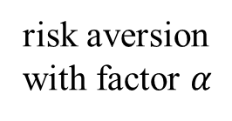
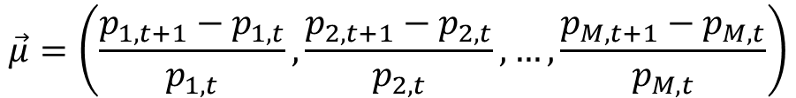

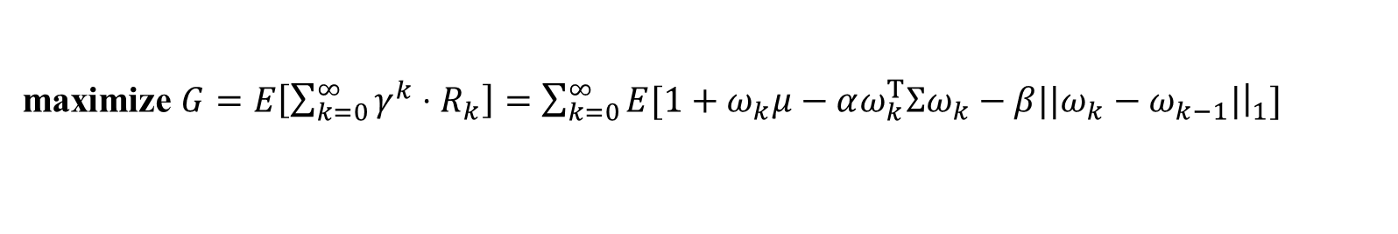
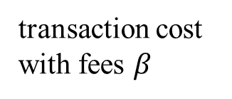
RL in Finance: The Big Three
Reward signal
At each time step $t$, we use the $log$ return to formulate our reward signal $R_{t}$, which has many advantages in real application
$$R_{t}=ln(1+{\vec{ω}}_{t}⋅\vec{μ} −α⋅{\vec{ω}}_{t}^{T}Σ{\vec{ω}}_{t} −β{\left|\left|{\vec{ω}}_{t}−{\vec{ω}}_{t−1}\right|\right|}_{1})$$
simple return
of portfolio
risk aversion
with factor $α$
transaction cost
with fees $β$
in which, $μ$ is the simple return of each asset
$$\vec{μ}=\left(\frac{p_{1,t+1}−p_{1,t}}{p_{1,t}}, \frac{p_{2,t+1}−p_{2,t}}{p_{2,t}},…,\frac{p_{M,t+1}−p_{M,t}}{p_{M,t}}\right)$$
Our final goal
maximize $G=E\left[\sum_{k=0}^{∞}{γ^{k}}⋅R_{k}\right]=\sum_{k=0}^{∞}{E[1+ω_{k}μ−αω_{k}^{T}Σω_{k}−β||ω_{k}−ω_{k−1}|{\left.​\right|}_{1}]}$

Slide 17

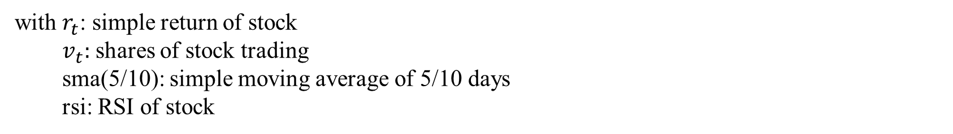

RL in Finance: Single Asset Toy Model
We implement a simple Deep-Q-learning with experience replay for single asset
Action
$A_{t}=$ (stock, cash) $∈\{\left[1,0\right],\left[0,1\right],[−1,2]\}$ with $1:$long, $0:$cover, $−1:$short
State
$S_{t}=$[ $r_{t}$, $v_{t}$, sma(5), sma(10), rsi ]
with $r_{t}$: simple return of stock
$v_{t}:$ shares of stock trading
sma(5/10): simple moving average of 5/10 days
rsi: RSI of stock
reward
$R_{t}=ln(1+\vec{ω}⋅\vec{μ})$
the simple return of the cash is the risk-free rate ($r_{f}=0$)

Slide 18
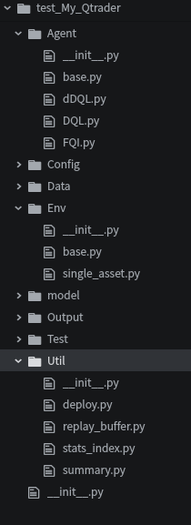






RL in Finance: Single Asset Toy Model
System Parameters
Q-network architecture: Fully-connected neural network with two hidden layers
fully-connected
fully-connected
$$[1,0]$$
$$[0,1]$$
$S_{t}$(5)
$$[−1,2]$$
64
32
$$Q(s,a)(3)$$
learning rate: ${10}^{−3}$, constant with no exponential decay
explore & exploit: $ε$-greedy policy, with $ε$ initialize to $1.0$ and decays to $0.1$
with increasing episodes
choose $a=\underset{a′}{argmax}{Q(s,a^{′})}$ with probability $1−ϵ$ (exploit)
$ϵ$-greedy
choose $a$ randomly with probability $ε$ (explore)
buffer size: 1024
mini-batch size: 64

Slide 19
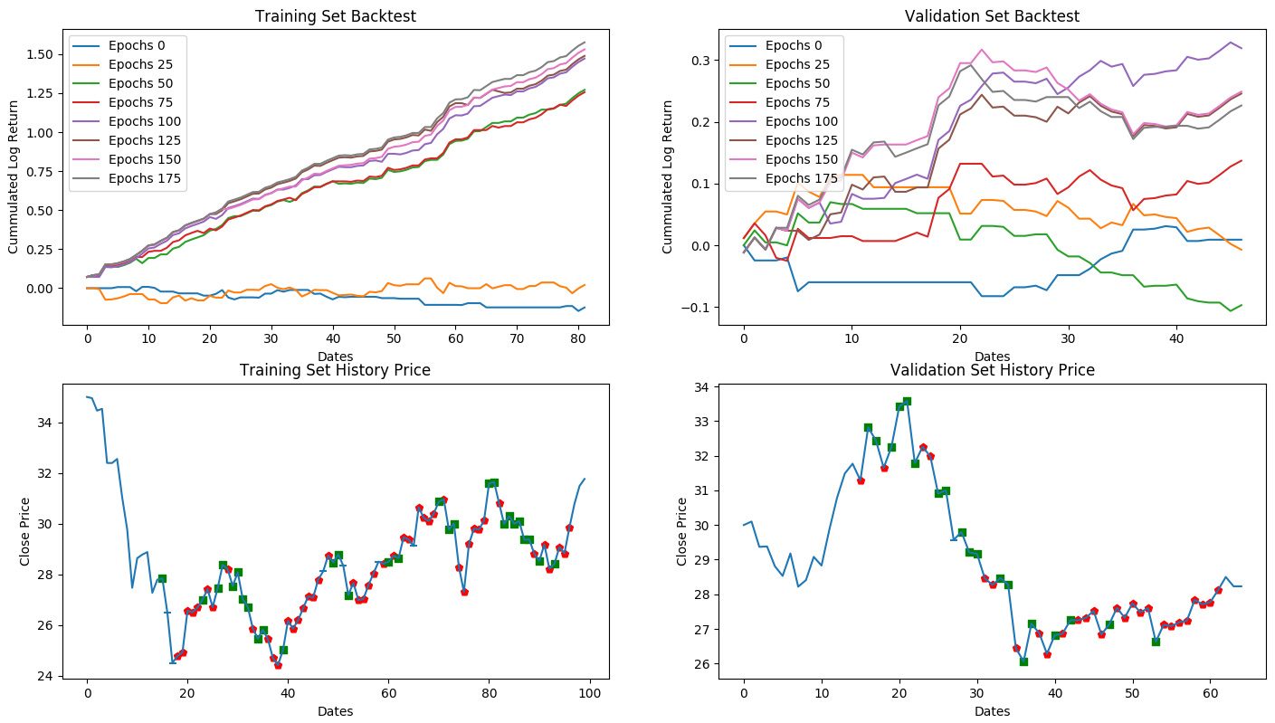
RL in Finance: Single Asset Toy Model
Notes:
64-32 layers, no dropout, Adam

Slide 20
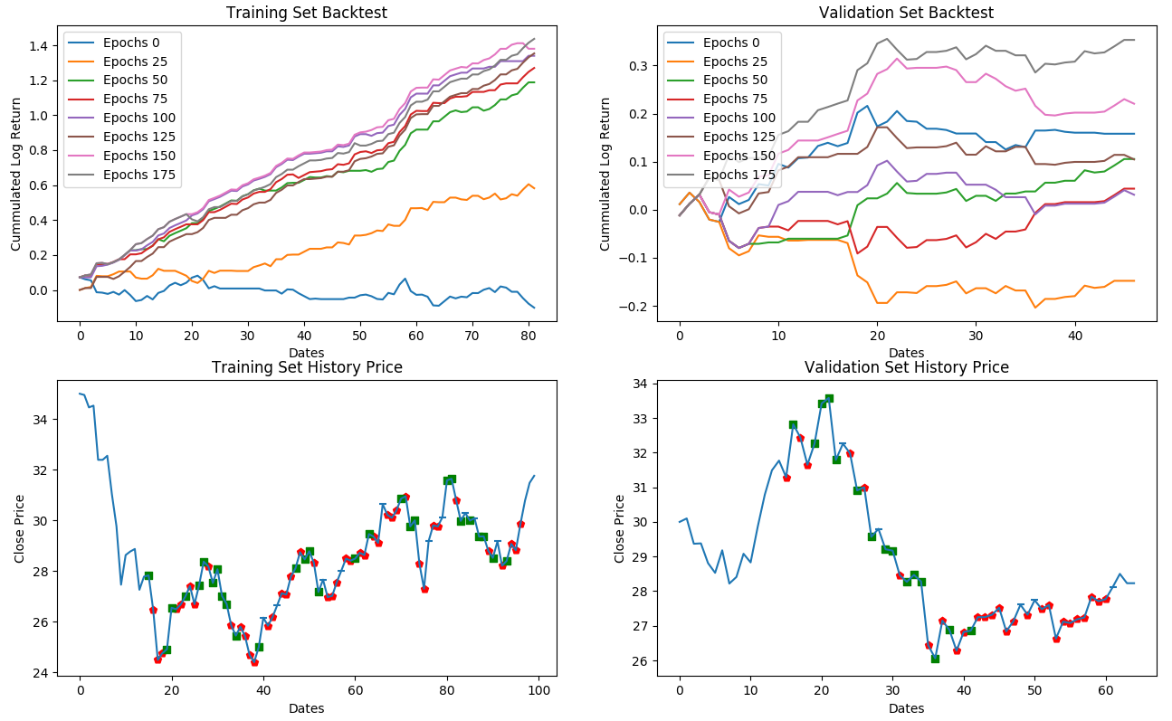
RL in Finance: Single Asset Toy Model
Notes:
32-16 layers, no dropout, Adam

Slide 21
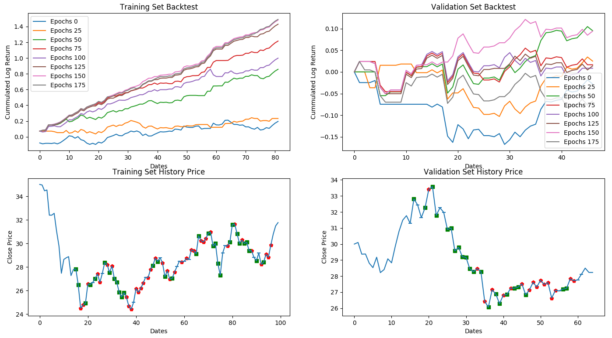
RL in Finance: Single Asset Toy Model
Notes:
64-32 layers, dropout 0.2, Adam

Slide 22
Future Improvements
Consider transaction cost and risk aversion
Longer time scale of data set and stock universe
Predictive representation of market state, CNN and RNN/LSTM/GRU
Neural network architecture with versatile techniques batch normalization, dropout, double Q-network, policy gradient (DDPG)
…

Slide 23
THANK YOU

